Slide 1
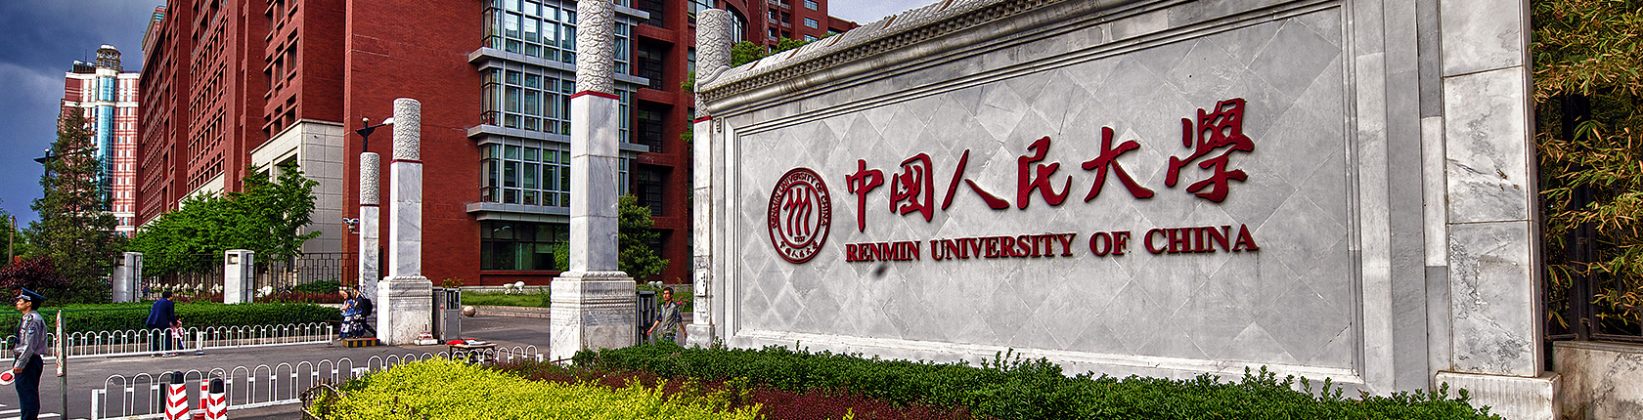
Characterizing Emerging Technologies of Global Digital Humanities Using Scientific Method Entities
Shaojian Li，Chengxi Yan
Remin University of China

Slide 2
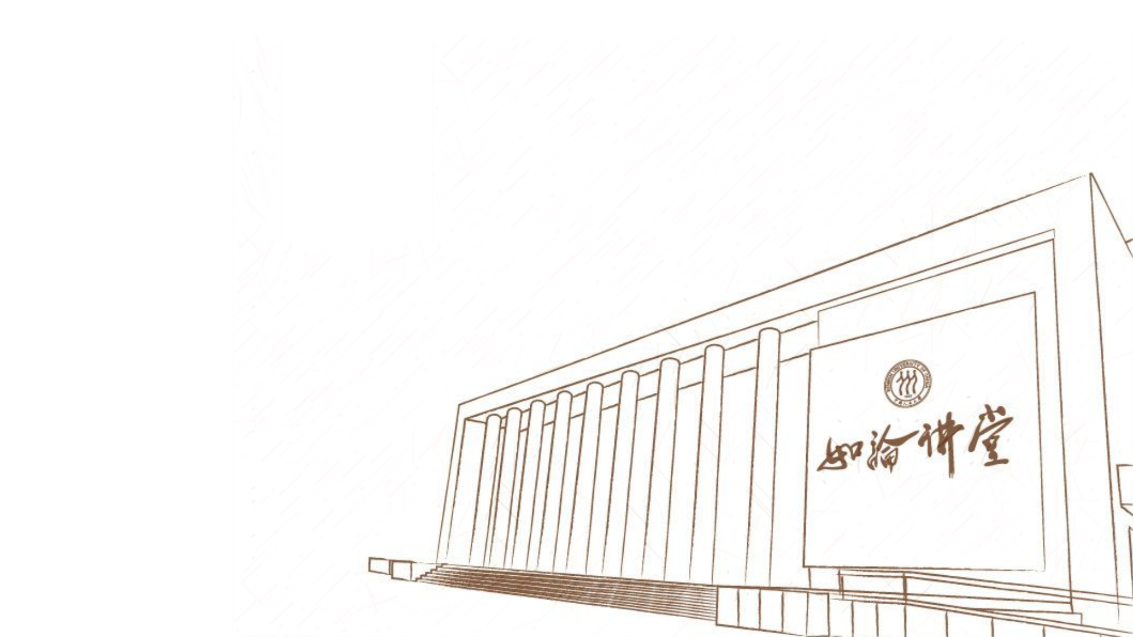
Research Motivation
Background
The emerging technology (ET) refers to those technical innovations which represent progressive developments within a field for competitive advantage, they are science-based innovations that have the potential to create a new industry or transform an existing one
The scientific method entites (SMEs) are good proxies for ETs, they provide an objective and systematic approach to characterizing ETs of global DH.
Challenges
traditional methods of extracting SMEs mostly use topic models and some manual methods. But the topic terms are usually general
the previous studies about DH only focus on the landscape of knowledge topics and structures in DH, while the detailed features of ETs (e.g. knowledge distribution, temporal evolution, etc.) are still unknown

Slide 3
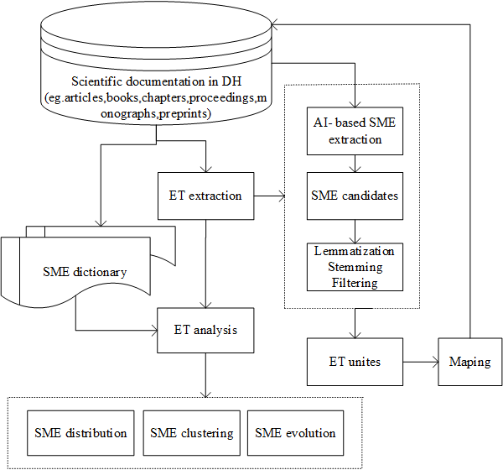
Research Solution
The contribution of our research are two-fold: One is a newly-designed approach based on AI-enchanced algorithm to automatically extract SMEs in DH domain; The other is a feature analysis on knowledge patterns related to ETs in DH in both static and dynamic ways.

Slide 4
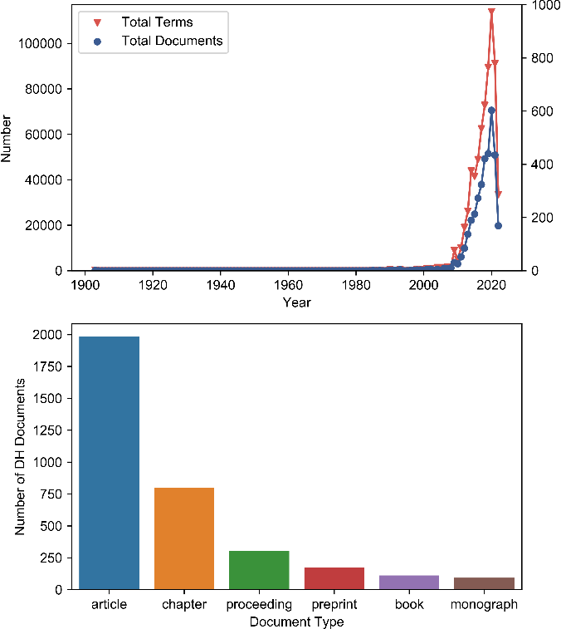
Research Solution
Data Collection & Text Processing
Dimensions Database
digital humanit* OR humanit* comput* OR ehumanit* OR e-humanit*
4398 documents. Through the removal of duplicate and unrelated documents, we finally obtain 3469 ones as the initial "target set".

Slide 5
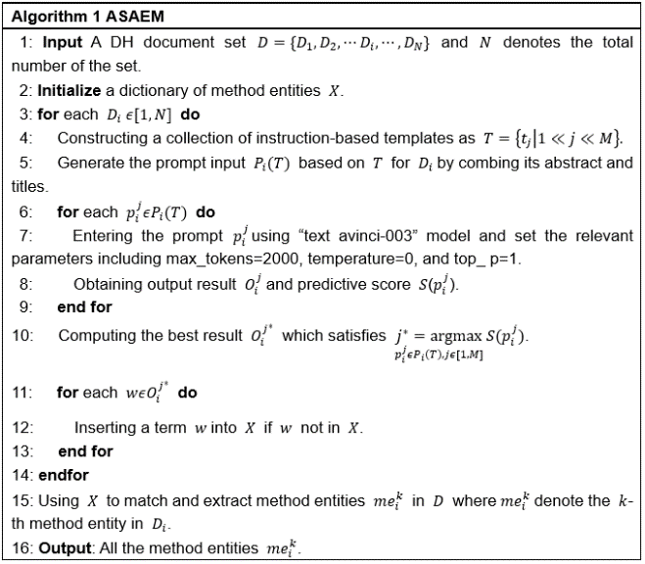
Research Solution
AI-based Extraction of SMEs
we propose an AI-empowered semi-automatic extraction method (ASAEM).
a state-of-the-art super language model “ChatGPT”is used to process documents and derive method-related entity candidates
we leverage the above dictionary to match and extract all the method entities from DH collections whilst excluding a small amount of general high-frequency terms

Slide 6
Research Solution
Detection and Clustering of ETs in DH
We mainly performed ETs co-occurrence clustering analysis and word frequency-based evolution over time on SMEs. We take relative strength index Equivalence coefficient as weights for edges and word frequency for nodes, importing them into gephi and use modular clustering to get clustering results.

Slide 7
Result Analysis
Distribution and Clustering of ETs.
Gi,j represents the co-occurrence times of keywords Wi and Wj in the same document, and Gi, Gj represent the total frequency of keywords Wi and Wj respectively. The calculation results are used for modular clustering of method entity distributions in the DH literature, acting as weights for edges established between ETs’ network.

Slide 8
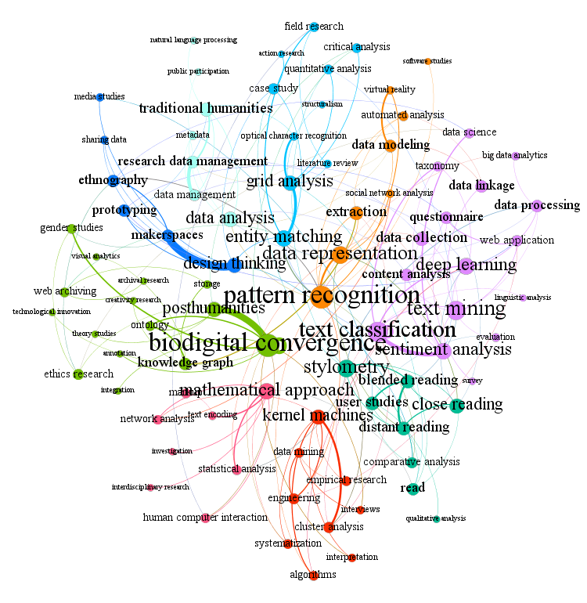
Result Analysis
ETs | SMEs(degree)
#1 | pattern recognition (13) , data representation (9), extraction (6) , data modeling (5) , automated analysis (3)
#2 | biodigitalconvergence(13) , posthumanities(7) , knowledge graph(5) , ethics research(4) , gender studies(3)
#3 | mathematical approach(8) , markup(3) , network analysis(3), human computer interaction(3) , statistical analysis(3)
#4 | kernel machines(7) , cluster analysis(4) , engineering(4) , data mining(3) , systematization(3) , algorithms(3)
#5 | Stylometry(9) , close reading(7) , distant reading(6) , user studies(6) , blended reading(6) , read(5)
#6 | entity matching(8) , grid analysis(7) , case study(4) , critical analysis(3) , quantitative analysis(3)
#7 | data analysis(7) , traditional humanities(6) , data management(4) , metadata(2) , natural language processing(1)
#8 | design thinking(7) , makerspaces(5) , ethnography(5) , prototyping(5) , media studies(2)
#9 | text calssification(11) , text mining(10) , data collection(6) , data processing(5) , data linkage(5)

Slide 9
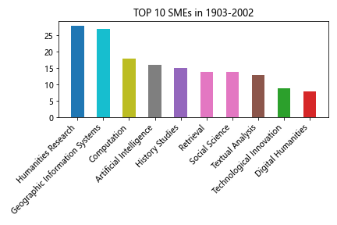
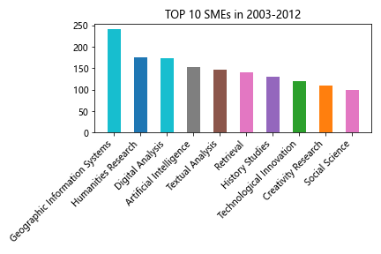
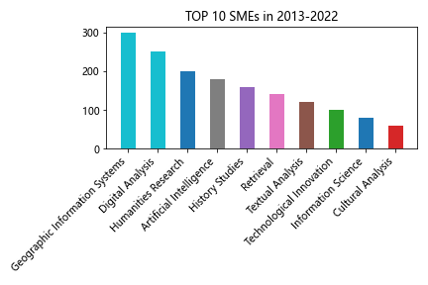
Result Analysis

Slide 10
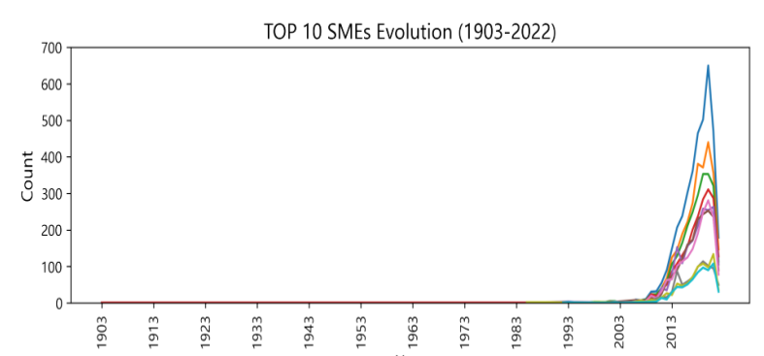
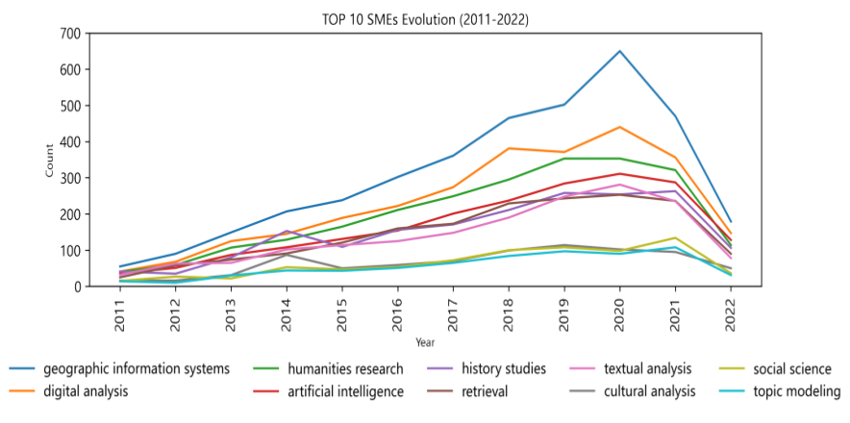
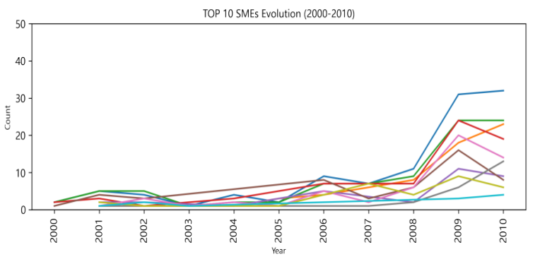
Result Analysis

Slide 11
Discussion and Conclusion
DH's ETs demonstrate that DH is an interdisciplinary field of study involving multiple disciplines.
DH's ETs have the characteristics of persistence.
DH's ETs also have the characteristics of partial shift.
DH's ETs have always maintained the characteristics of a combination of digital and humanities

Slide 12
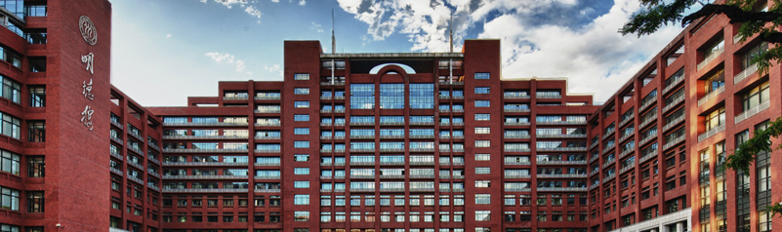
Thank you very much !
If you are interested, please contact us with lishj27@ruc.edu.cn

